Slide 1
Computer Organization
Chapter 5
The arithmetic logic unit

Slide 2
Chapter 5 The arithmetic logic unit
5.1 The von Neumann computer model
5.2 Parallel fast adders
5.3 Analysis of the design of a commercial ALU Chip
5.4 Summary

Slide 3
5.1 The von Neumann computer model
The vast majority of computer systems used today are constructed on the van Neumann computer model.
A computer is viewed as a stored program computer.
A program is a sequence of instructions, each of which performs a basic operation.
Before execution, the program is stored in memory along with data to be manipulated.
When executed, the instructions in it are retrieved from memory, one after another, and brought into the processing unit. Decodes instruction, retrieve data, perform operation, stores result in register or memory.
Notes:
现今使用中的大多数计算机系统都是在冯·诺依曼计算机模型上构造的。
该模型于1946年由冯·诺依曼提出。
计算机被看作是一个存储程序计算机。
一道程序是一个指令序列，其中每一条指令执行一个基本操作。
执行前，程序和将要由它加工的数据一起存放到存储器中。
在程序执行中，它的指令一条一条地从存储器读出，送到处理单元中去。处理单元译码、取数，执行，并写回结果。
因此冯·诺依曼机型典型组成包含：存储器，CPU，I/O

Slide 4
5.1 The von Neumann computer model
Typically consists of 3 functional blocks: a central processing unit (CPU), main memory, an input/output system (I/O).
Main
memory
Input/
Output
Control unit
registers
Internal Bus
ALU
CPU
External
Bus
The basic organization of a stored-program computer
Notes:
中央处理器组成为一个有限状态机，它的状态随指令执行的结果而改变。像CPU这样的有限状态机应包含一个存储部分和一个组合部分，前者是寄存器，后者是算术逻辑单元和控制器，用以实现指令的序列控制。
输入输出子系统作为计算机和外部世界之间的接口。
外总线让所有这些函数部件连接起来并相互通信。

Slide 5
5.2 Parallel fast adders
An arithmetic unit (ALU) is the heart of the CPU
The ALU usually has a binary adder
The performance of the ALU is mainly determined by its adder.
We need to design a fast adder to get rid of the excessive carry-propagation time of the ripple-carry adder.
Notes:
算术逻辑单元（ALU）是CPU的心脏。
通常ALU有一个二进制加法器。
ALU的性能主要取决于它的加法器
所以要设计一个快速加法器来解决行波进位加法器速度慢的问题。

Slide 6
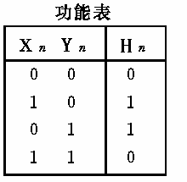

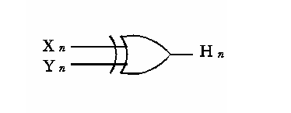
5.2 Parallel fast adders
Design of a half adder
  Add of Xn，Yn is called half adder, regardless of carry item.
  obtain a truth table
  Given the expression of half adder and H_{n}：
    H_{n}=X_{n}· Y_{n} + X_{n}·Y_{n}=X_{n}Y_{n}
  Figure gives its logic map, which can be implemented by XOR gate
Notes:
半加器设计(加法器是计算机基本运算部件之一)
不考虑进位输入时，两数码Xn，Yn相加称为半加器。
由真值表写出半加和H_{n}的表达式如下：
H_{n}=X_{n}· Y_{n} + X_{n}·Y_{n}=X_{n}Y_{n}
图(b)是它的逻辑图。半加器可用反相门及与或非门来实现，也可用异或门来实现。

Slide 7
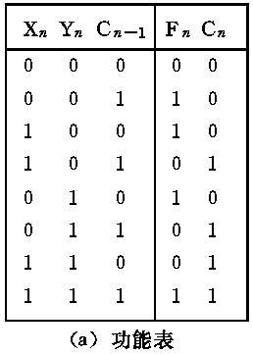
5.2 Parallel fast adders
Design of a full adder
  Full adder: considering carry bit C_{n-1}。Result of full adder and carry bit are given below:
  Fn＝XnYnCn-1+ XnYnCn-1
  + XnYnCn-1+ XnYnCn-1
  Cn＝ XnYnCn-1+ XnYnCn-1
  + XnYnCn-1+ XnYnCn-1
Notes:
全加器设计
若考虑低位进位输入C_{n-1}相加，则称为全加器。图(a)是其功能表。全加和Fn和进位输出Cn的表示式分别为：

Slide 8
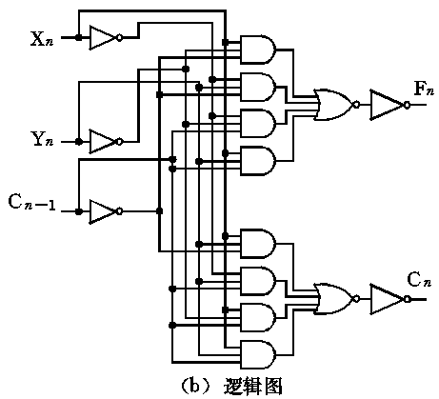
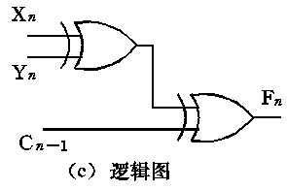
5.2 Parallel fast adders
Design of a full adder
  Fn＝XnYnCn-1+ XnYnCn-1
  + XnYnCn-1+ XnYnCn-1
  Cn＝ XnYnCn-1+ XnYnCn-1
  + XnYnCn-1+ XnYnCn-1
  Implemented by two half adder
  F_{n}=X_{n} Y_{n} C_{n-1}
Notes:
全加器还可用两个半加器来形成。
F_{n}是X_{n}、Y_{n}相加再和C_{n-1}相加的结果

Slide 9
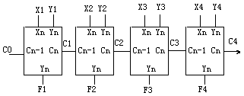
5.2 Parallel fast adders
N-bit ripple-carry adder（行波进位加法器）
  A n bit adder can be produced by connecting n full adders
  Carry is transferred serially, and F_{i} is calculated when C_{i-1} is coming.
  Time consumed is determined by number of bits.
  The block diagram of an n-bit ripple-carry adder
A simple 4 bits serial full adder
Notes:
全加器设计
将n个全加器相连可得n位加法器，但其加法时间较长。
这是因为其位间进位是串行传送的，本位全加和F_{i}必须等低位进位C_{i-1}来到后才能进行，加法时间与位数有关。

Slide 10
5.2 Parallel fast adders
Design of a fast adder
  How to improve the speed of adder?
  Change the pathway of one by one carry bits
  Cn＝ XnYnCn-1+ XnYnCn-1 + XnYnCn-1+ XnYnCn-1
＝(Xn+Yn) Cn-1+ XnYn
  The carry of the full adder of the Ci depends on the Ci-1
  Although n full adders work in parallel, the carry signals are generated and propagated in sequential.
  The worst-case of carry propagation occurs when a carry signal propagates from C0 to Cn all the way along the carry propagation circuit.
Notes:
怎样才能提高加法器的工作速度？
只有通过改变进位逐位传送的路径来解决。

Slide 11
5.2 Parallel fast adders
Carry look-ahead（超前进位） It reduces significantly the carry creation time by generating the carry signals for all the bits at once directly from the input carry C₀
The nature of carry propagation
  C₁ is generated as long as one of these two conditions is meeting：
    (1) Both of X₁，Y₁ are“1”；
    (2) Either of X₁，Y₁ is“1”，and C₀ is“1”。
  Then C₁ can be expressed ：
    C₁=X₁Y₁+(X₁+Y₁)C₀
Notes:
解决办法之一是采用“超前进位产生电路”来同时形成各位进位，从而实现快速加法。我们称这种加法器为超前进位加法器。
超前进位产生电路是根据各位进位的形成条件来实现的。
只要满足下述两条件中任一个，就可形成C₁：
(1)X₁，Y₁均为“1”；
(2)X₁，Y₁任一个为“1”，且进位C₀为“1”。
由此，可写得C₁的表达式为：C₁=X₁Y₁+(X₁+Y₁)C₀

Slide 12
5.2 Parallel fast adders
The nature of carry propagation
  C₂ is generated as long as one of the following conditions is satisfied：
    (1) Both of X₂ and Y₂ are“1”；
    (2) Either of X₂ and Y₂ is“1”，and X₁ and Y₁ are“1”；
    (3) Either of X₂ and Y₂ is“1”，and either of X₁ and Y₁ is“1”，with C₀ is“1”
  Then C₂ can be expressed ：
    C₂=X₂Y₂
    +(X₂+Y₂)X₁Y₁
    +(X₂+Y₂)(X₁+Y₁)C₀

Slide 13
5.2 Parallel fast adders
The nature of carry propagation
  Similarly，C₃ and C₄ can be calculated：
    C₃=X₃Y₃
    +(X₃+Y₃)X₂Y₂
    +(X₃+Y₃)(X₂+Y₂)X₁Y₁
    +(X₃+Y₃)(X₂+Y₂)(X₁+Y₁)C₀
    C₄=X₄Y₄
    +(X₄+Y₄)X₃Y₃
    +(X₄+Y₄)(X₃+Y₃)X₂Y₂
    +(X₄+Y₄)(X₃+Y₃)(X₂+Y₂)X₁Y₁
    +(X4+Y4)(X3+Y3)(X2+Y2)(X1+Y1)C0

Slide 14
5.2 Parallel fast adders
The nature of carry propagation
  Carry propagate function P_{i} and carry generate function G_{i}：
  G_{i}=X_{i}·Y_{i} carry generate function
  P_{i}=X_{i}+Y_{i} carry propagate function
    G_{i}：when X_{i} and Y_{i} are“1”，no matter whether there is low-order carry bit，the current carry bit is generated.
    P_{i}：when either of X_{i} and Y_{i} is 1，if there exist low-order carry bit, then C_{i-1} is propagated to high-order carry bit
Notes:
下面我们引入进位传递函数P_{i}和进位产生函数G_{i}的概念。它们的定义为：
G_{i}=X_{i}·Y_{i} 称为进位产生函数
P_{i}=X_{i}+Y_{i} 称为进位传递函数
G₁的意义是：当X₁，Y₁均为“1”时，不管有无进位输入，定会产生向高位的进位。
P₁的意义是：当X₁，Y₁中有一个为“1”时，若有进位输入，则本位向高位传送进位，这个进位可看成是低位进位越过本位直接向高位传递的。

Slide 15
5.2 Parallel fast adders
The nature of carry propagation
  Put P₁, G₁ into C₁～C₄：
  C₁=G₁+P₁C₀ （low-order bit）
  C₂=G₂+P₂G₁+P₂P₁C₀
  C₃=G₃+P₃G₂+P₃P₂G₁+P₃P₂P₁C₀
  C₄=G₄+P₄G₃+P₄P₃G₂+P₄P₃P₂G₁+P₄P₃P₂P₁C₀

Slide 16
5.2 Parallel fast adders
The nature of carry propagation
  Since the input variables take inverted values, its output generates the inverted variables, “NAND ”, “NOR” . “AND-OR-NOT” can be readjusted as:
  G_{i}=X_{i}·Y_{i} G_{i}=X_{i}·Y_{i} =X_{i}+Y_{i} carry generate
  P_{i}=X_{i}+Y_{i} P_{i}=X_{i}+Y_{i} = X_{i}·Y_{i} carry propagate
  G_{i}·P_{i} = (X_{i}+Y_{i}) · X_{i}·Y_{i} = X_{i}·Y_{i} =P_{i}
  C1 = G1+P1C0
  C1 = G1+P1C0 =G1·P1C0 =G1·(P1+C0)
  = G1·P1+G1·C0 = P1+G1·C0

Slide 17
5.2 Parallel fast adders
The nature of carry propagation
  C1=P1+G1C0
  C2=P2+G2P1+G2G1C0
  C3=P3+G3G2+ G3G2P1+G3G2G1C0
  C4=P4+G4P3+G4G3P2+G4G3G2P1+ G4G3G2G1C0

Slide 18
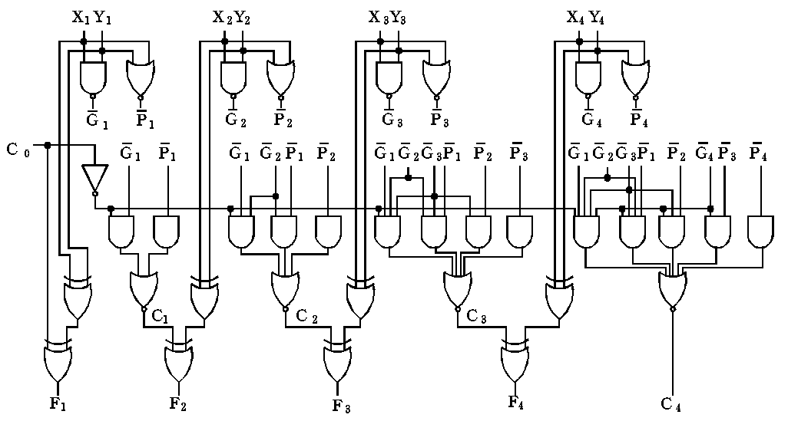
5.2 Parallel fast adders
The four-bit carry look-ahead adder

Slide 19
5.3 Analysis of the design of a commercial ALU chip
The four-bit carry look-ahead adder
G P S₃ S₂ S₁ S₀
4-bit carry
look-ahead adder
C₀
C₃
A₃B₃ A₂B₂ A₁B₁ A₀B₀

Slide 20
5.3 Analysis of the design of a commercial ALU chip
The four-bit carry look-ahead adder
G P S₃ S₂ S₁ S₀
G P S₃ S₂ S₁ S₀
4-bit carry
look-ahead adder
4-bit carry
look-ahead adder
C₀
C₃
C₀
C₃
A₃B₃ A₂B₂ A₁B₁ A₀B₀
A₃B₃ A₂B₂ A₁B₁ A₀B₀

Slide 21
5.2 Parallel fast adders
The block carry look-ahead circuit
  Theoretically speaking, expression C1~C4 can be expanded to higher order bits up to n-1 for n>4.
  However, as the bit number increases, the number of product terms and maximum number of literals in a product term in the expression would increase proportionally.
  So we limit the fan-in of an AND gate or an OR gate to 5.
  The maximal allowable size of a single-stage carry look-ahead circuit is 4 bits.
Notes:
分块式先行进位加法器线路
理论上说，表达式可以扩展到更高的位，直至n-1,（对于n>4）
然而，当位数增加时，表达式中积项的数目以及每个积项的变量数都将成比例的增长。
这里我们限制一个或非门的最大输入端为5
这样就得到了一个4位的先行进位传递线路。

Slide 22
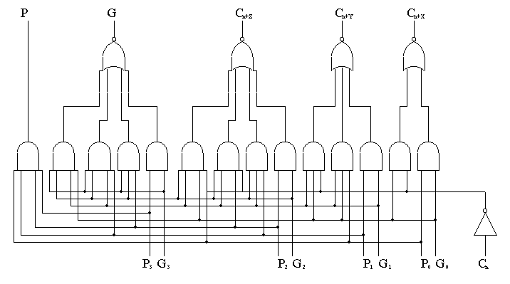
5.2 Parallel fast adders
The block carry look-ahead circuit
4位的先行进位传递线路

Slide 23
5.2 Parallel fast adders
The block carry look-ahead circuit
G’= G₃+P₃G₂+P₃P₂G₁+P₃P₂P₁G₀
P’= P₃P₂P₁P₀
G’ P’ C₃ C₂ C₁
74182
C₀
G₃P₃ G₂P₂ G₁P₁ G₀P₀

Slide 24
5.2 Parallel fast adders
The block carry look-ahead circuit
G P
74182
C0
G4 P4 C3 G3 P3 C2 G2 P2 C1 G1 P1
F15~F12
F11~F8
F7~F4
F3~F0
Adder
Adder
Adder
Adder
C0
B15~B12
B11~B8
B7~B4
B3~B0
A15~A12
A11~A8
A7~A4
A3~A0
16-bit fast adders

Slide 25
5.3 Analysis of the design of a commercial ALU chip
ALU can implement basic arithmetic operations and logical operations.
This section analyze the design process of the commercial 4-bits ALU chip SN74181.
Notes:
算术逻辑单元（ALU）
ALU是一种功能较强的组合逻辑电路。它能进行多种算术运算和逻辑运算。ALU的基本逻辑结构是超前进位加法器，它通过改变加法器的进位产生函数G和进位传递函数P来获得多种运算能力。下面通过介绍SN74181型四位ALU中规模集成电路来介绍ALU的原理。

Slide 26
5.3 Analysis of the design of a commercial ALU chip
SN74181
S₃ | S₂ | S₁ | S₀ | Positive logic
 |  |  |  | M=H Logic op | M=L arithmetic operation
 |  |  |  |  | C_{n}=1 | C_{n}=0
L | L | L | L | A | A | A add 1
L | L | L | H | A+B | A+B | (A+B) add 1
L | L | H | L | A·B | A+B | (A+B) add 1
L | L | H | H | “0” | Sub 1 | “0”
L | H | L | L | A·B | A add (A·B) | A add(A·B)add 1
L | H | L | H | B | (A·B) add (A+B) | (A·B)add(A+B)add1
L | H | H | L | AB | A sub B sub 1 | A sub B
L | H | H | H | A·B | (A·B) sub1 | A·
⊕
Logic maps and function table of 4-bits ALU

Slide 27
5.3 Analysis of the design of a commercial ALU chip
SN74181
S₃ | S₂ | S₁ | S₀ | Positive logic
 |  |  |  | M=H Logic op | M=L arithmetic operation
 |  |  |  |  | C_{n}=1 | C_{n}=0
H | L | L | L | A+B | A add(A·B) | A add(A·B)add 1
H | L | L | H | A B | A add B | A add B add 1
H | L | H | L | B | (A·B)add(A+B) | (A·B)add(A+B)add 1
H | L | H | H | A·B | (A·B)sub1 | A·B
H | H | L | L | “1” | A add A | A add A add 1
H | H | L | H | A+B | A add (A+B) | A add (A+B)add 1
H | H | H | L | A+B | A add (A+B) | Aadd(A+B)add 1
H | H | H | H | A | A sub 1 | A
⊕
Logic maps and function table of 4-bits ALU

Slide 28
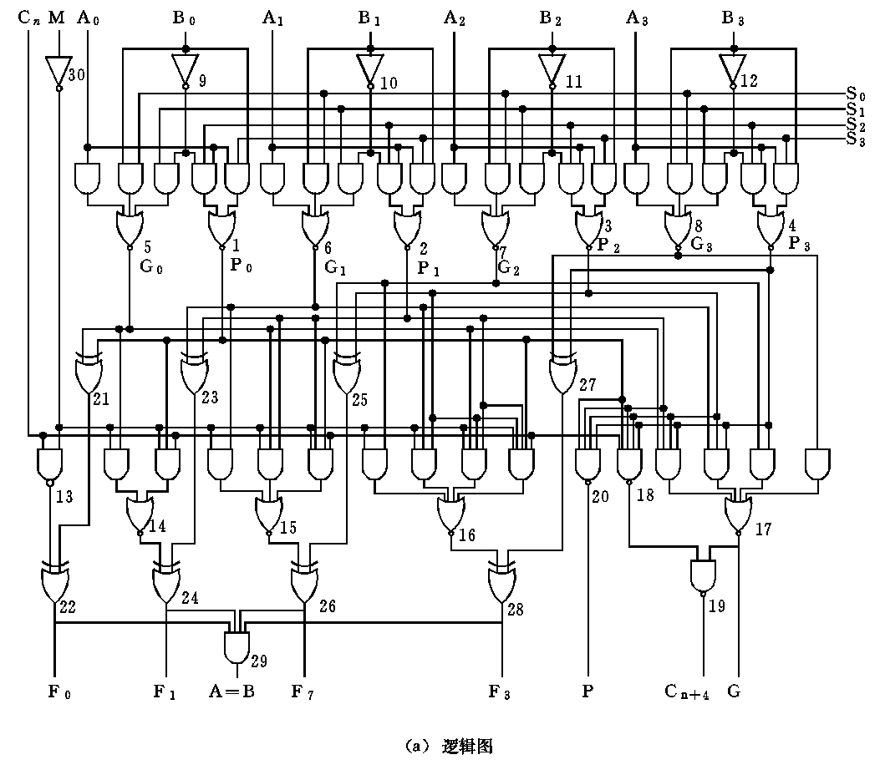
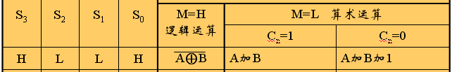
0
0
0
0
0
0
0
0
G₀ = A₀+B₀ = A₀ B₀
P₀ = A₀ B₀ = A₀+B₀
0
0
0
0
0
0
0
0
0
0
G₀⊕P₀ = G₀P₀ + G₀P₀
= (A₀+B₀)(A₀+B₀) + (A₀ B₀)(A₀B₀)
= 0+A₀B₀ + A₀B₀ + 0+0
= A₀⊕B₀
1
1
1
1
Notes:
我们以S₃S₂S₁S₀=HLLH为例来详细的介绍一下这个算数逻辑单元的组成。
首先我们假设M=H 来看看逻辑，红色线条代表H，蓝色线条代表L
异或们21、23、25、27实现的是Ai⊕Bi
异或们22、24、26、28又分别和1异或，相当于取反。
所以总的就实现了A⊕B

Slide 29
0
0
0
0
0
0
0
0
A₀B₀ C₀
⊕
⊕
A₁B₁ C₁
⊕
⊕

Slide 30
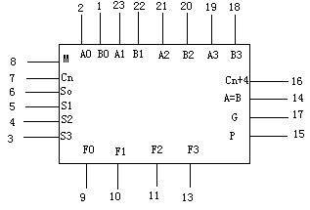
5.3 Analysis of the design of a commercial ALU chip
SN74181
Pins of 74181

Slide 31
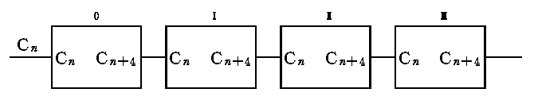
5.3 Analysis of the design of a commercial ALU chip
16-bits ALU
  Four 74181 circuits can forms 16-bits ALU
  Fast carry in chip, and one by one between chips. So it would take relative long time to generate F₀～F₁₅
16-bits ALU formed by 4 ALU chips

Slide 32
5.3 Analysis of the design of a commercial ALU chip
16-bits ALU
  Take 4 bits as a group. Using method like “4-bit carry look-ahead adder” to implement 16-bits ALU (formed by 4 ALU chips)，a 16-bit fast ALU can be gained.
  74181 ALU can generate Gn，Pn，then 16-bit fast ALU can be implemented by AND OR NOT gates and 4 ALU chips
  74182 (Look-ahead carry extender) can be gained by implementing logic circuit of Cn1、Cn2、Cn3

Slide 33
5.3 Analysis of the design of a commercial ALU chip
16-bits fast ALU
G P
74182
C0
G4 P4 C3 G3 P3 C2 G2 P2 C1 G1 P1
F15~F12
F11~F8
F7~F4
F3~F0
74181
74181
74181
74181
C0
B15~B12
B11~B8
B7~B4
B3~B0
A15~A12
A11~A8
A7~A4
A3~A0
16-bit fast ALU

Slide 34
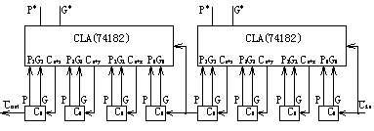
5.3 Analysis of the design of a commercial ALU chip
32-bits fast ALU
  Two 16-bit 74182 and eight 74181 can form a 32-bit ALU circuit

Slide 35
5.3 Analysis of the design of a commercial ALU chip
64-bits fast ALU
  Construct a 64-bit ALU circuit by 4 16-bit 74182 chips and 16 74181 chips.
  How to make it faster?
  With the increasing of integration, ALU with more bits can be integrated in one chip. For example, AM29332 (32 bit ALU), produced by AMD. In pentium series processor, produced by Intel, 32 bit ALU is only a part of the Chip. The basic principles are the same although the devices used are different

Slide 36
Summary
5.1 The von Neumann computer model
  Typically consists of 3 functional blocks: a central processing unit (CPU), main memory, an input/output system (I/O).
5.2 Parallel fast adders
  Carry look-ahead G = X Y P = X+Y
  C₁=G₁+P₁C₀ （low-order bit）
  C₂=G₂+P₂G₁+P₂P₁C₀
  C₃=G₃+P₃G₂+P₃P₂G₁+P₃P₂P₁C₀
  C₄=G₄+P₄G₃+P₄P₃G₂+P₄P₃P₂G₁+P₄P₃P₂P₁C₀
  SN74182 (carry look-ahead generator)
5.3 Analysis of the design of a commercial ALU Chip
  SN74181 (4 bit ALU) 16bit fast ALU 32bit fast ALU

